Slide 1
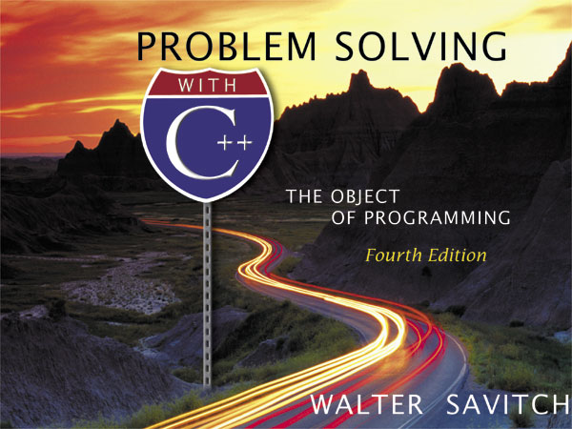

Slide 2
Chapter 12
Pointers
and
Dynamic Arrays
Created by David Mann, North Idaho College

Slide 3
Overview
Pointers (12.1)
Dynamic Arrays (12.2)
Classes and Dynamic Arrays(12.3)

Slide 4
Pointers
12.1
A pointer is the memory address of a variable
Memory addresses can be used as names for
variables
  If a variable is stored in three memory locations,
  the address of the first can be used as a name for
  the variable.
  When a variable is used as a call-by-reference
  argument, its address is passed

Slide 5
Pointers Tell
Where To Find A Variable
An address used to tell where a variable is stored
in memory is a pointer
  Pointers "point" to a variable by telling where the
  variable is located

Slide 6
Declaring Pointers
Pointer variables must be declared to have a
pointer type
  Example: To declare a pointer variable p that can
  "point" to a variable of type double:
  double *p;
  The asterisk identifies p as a pointer variable

Slide 7
Multiple Pointer Declarations
To declare multiple pointers in a statement, use
the asterisk before each pointer variable
  Example:
  int *p1, *p2, v1, v2;
  p1 and p2 point to variables of type int
  v1 and v2 are variables of type int

Slide 8
The address of Operator
The & operator can be used to determine the
address of a variable which can be assigned to a
pointer variable
  Example: p1 = &v1;
  p1 is now a pointer to v1
  v1 can be called v1 or "the variable pointed to
  by p1"

Slide 9
The Dereferencing Operator
C++ uses the * operator in yet another way with
pointers
  The phrase "The variable pointed to by p" is
  translated into C++ as *p
  Here the * is the dereferencing operator
    p is said to be dereferenced

Slide 10
A Pointer Example
v1 = 0;
p1 = &v1;
*p1 = 42;
cout << v1 << endl;
cout << *p1 << endl;
output:
42
42
v1 and *p1 now refer to
the same variable

Slide 11
Pointer Assignment
The assignment operator = is used to assign
the value of one pointer to another
  Example: If p1 still points to v1 (previous slide)
  then
  p2 = p1;
  causes *p2, *p1, and v1 all to name
  the same variable

Slide 12
Caution! Pointer Assignments
Some care is required making assignments to
pointer variables
  p1= p3; // changes the location that p1 "points" to
  *p1 = *p3; // changes the value at the location that
  // p1 "points" to
Display 12.1

Slide 13
The new Operator
Using pointers, variables can be manipulated
even if there is no identifier for them
  To create a pointer to a new "nameless" variable of
  type int:
  p1 = new int;
  The new variable is referred to as *p1
  *p1 can be used anyplace an integer variable can
  cin >> *p1;
  *p1 = *p1 + 7;

Slide 14
Dynamic Variables
Variables created using the new operator are
called dynamic variables
  Dynamic variables are created and destroyed while
  the program is running
  Additional examples of pointers and dynamic
  variables are shown in
  An illustration of the code in Display 12.2 is
  seen in
Display 12.2
Display 12.3

Slide 15
new and Class Types
Using operator new with class types calls
a constructor as well as allocating memory
  If MyType is a class type, then
  MyType *myPtr; // creates a pointer to a
  // variable of type MyType
  myPtr = new MyType;
  // calls the default constructor
  myPtr = new MyType (32.0, 17);
  // calls Mytype(double, int);

Slide 16
Basic Memory Management
An area of memory called the freestore is
reserved for dynamic variables
  New dynamic variables use memory in the freestore
  If all of the freestore is used, calls to new will fail
Unneeded memory can be recycled
  When variables are no longer needed, they can
  be deleted and the memory they used is returned
  to the freestore

Slide 17
The delete Operator
When dynamic variables are no longer needed,
delete them to return memory to the freestore
  Example:
  delete p;
  The value of p is now undefined and the memory
  used by the variable that p pointed to is back in
  the freestore

Slide 18
Dangling Pointers
Using delete on a pointer variable destroys the
dynamic variable pointed to
If another pointer variable was pointing to the
dynamic variable, that variable is also undefined
Undefined pointer variables are called
dangling pointers
  Dereferencing a dangling pointer (*p) is usually
  disasterous

Slide 19
Automatic Variables
Variables declared in a function are created by
C++ and destroyed when the function ends
  These are called automatic variables because their
  creation and destruction is controlled automatically
The programmer manually controls creation and
destruction of pointer variables with operators
new and delete

Slide 20
Global Variables
Variables declared outside any function definition
are global variables
  Global variables are available to all parts of a program
  Global variables are not generally used

Slide 21
Type Definitions
A name can be assigned to a type definition,
then used to declare variables
The keyword typedef is used to define new
type names
  Syntax:
  typedef Known_Type_Definition New_Type_Name;
    Known_Type_Definition can be any type

Slide 22
Defining Pointer Types
To avoid mistakes using pointers, define a
pointer type name
  Example: typedef int* IntPtr;
  Defines a new type, IntPtr, for pointer
  variables containing pointers to int variables
  IntPtr p;
  is equivalent to
  int *p;

Slide 23
Multiple Declarations Again
Using our new pointer type defined as
typedef int* IntPtr;
  Prevent this error in pointer declaration:
  int *P1, P2; // Only P1 is a pointer variable
with
IntPtr P1, P2; // P1 and P2 are pointer
// variables

Slide 24
Pointer Reference Parameters
A second advantage in using typedef to
define a pointer type is seen in parameter lists
  Example: void sample_function(IntPtr& pointer_var);
  is less confusing than
  void sample_function( int*& pointer_var);

Slide 25
Section 12.1 Conclusion
Can you
  Declare a pointer variable?
  Assign a value to a pointer variable?
  Use the new operator to create a new variable in the
  freestore?
  Write a definition for a type called NumberPtr to be
  a type for pointers to dynamic variables of type int?
  Use the NumberPtr type to declare a pointer variable
  called my_point?

Slide 26
Dynamic Arrays
12.2
A dynamic array is an array whose size is
determined when the program is running, not
when you write the program

Slide 27
Pointer Variables and Array Variables
Array variables are actually pointer variables
that point to the first indexed variable
  Example: int a[10];
  typedef int* IntPtr;
  IntPtr p;
    Variables a and p are the same kind of variable
Since a is a pointer variable that points to a[0],
p = a;
causes p to point to the same location as a

Slide 28
Pointer Variables
As Array Variables
  Continuing the previous example:
  Pointer variable p can be used as if it were an
  array variable
  Example: p[0], p[1], …p[9]
  are all legal ways to use p
  Variable a can be used as a pointer variable
  except the pointer value in a cannot be changed
    This is not legal: IntPtr p2;
    … // p2 is assigned a value
    a = p2 // attempt to change a
Display 12.4

Slide 29
Creating Dynamic Arrays
Normal arrays require that the programmer
determine the size of the array when the program
is written
  What if the programmer estimates too large?
    Memory is wasted
  What if the programmer estimates too small?
    The program may not work in some situations
Dynamic arrays can be created with just the
right size while the program is running

Slide 30
Creating Dynamic Arrays
Dynamic arrays are created using the new
operator
  Example: To create an array of 10 elements of
  type double:
  typedef double* DoublePtr;
  DoublePtr d;
  d = new double[10];
    d can now be used as if it were an ordinary array!
This could be an
integer variable!

Slide 31
Dynamic Arrays (cont.)
Pointer variable d is a pointer to d[0]
When finished with the array, it should be
deleted to return memory to the freestore
  Example: delete [ ] d;
    The brackets tell C++ a dynamic array is being deleted
    so it must check the size to know how many indexed
    variables to remove
    Forgetting the brackets, is not
    legal, but would tell the
    computer to remove only one variable
Display 12.5 (1)
Display 12.5 (2)

Slide 32
Pointer Arithmetic (Optional)
Arithmetic can be performed on the addresses
contained in pointers
  Using the dynamic array of doubles, d, declared
  previously, recall that d points to d[0]
  The expression d+1 evaluates to the address of d[1]
  and d+2 evaluates to the address of d[2]
    Notice that adding one adds enough bytes for one
    variable of the type stored in the array

Slide 33
Pointer Arthmetic Operations
You can add and subtract with pointers
  The ++ and - - operators can be used
  Two pointers of the same type can be subtracted to
  obtain the number of indexed variables between
    The pointers should be in the same array!
  This code shows one way to use pointer
  arithmetic:
  for (int i = 0; i < array_size; i++)
  cout << *(d + i) << " " ;
  // same as cout << d[i] << " " ;

Slide 34
Multidimensional Dynamic Arrays
To create a 3x4 multidimensional dynamic array
  View multidimensional arrays as arrays of arrays
  First create a one-dimensional dynamic array
    Start with a new definition:
    typedef int* IntArrayPtr;
    Now create a dynamic array of pointers named m:
    IntArrayPtr *m = new IntArrayPtr[3];
  For each pointer in m, create a dynamic array of int's
    for (int i = 0; i<3; i++)
    m[i] = new int[4];

Slide 35
A Multidimensial
Dynamic Array
The dynamic array created on the previous slide
could be visualized like this:
m
IntArrayPtr's
IntArrayPtr *
int's

Slide 36
Deleting
Multidimensional Arrays
To delete a multidimensional dynamic array
  Each call to new that created an array must have
  a corresponding call to delete[ ]
  Example: To delete the dynamic array created
  on a previous slide:
  for ( i = 0; i < 3; i++)
  delete [ ] m[i]; //delete the arrays of 4 int's
  delete [ ] m; // delete the array of IntArrayPtr's
Display 12.6 (1)
Display 12.6 (2)

Slide 37
Section 12.2 Conclusion
Can you
  Write a definition for pointer variables that will be
  used to point to dynamic arrays? The array elements
  are of type char. Call the type CharArray.
  Write code to fill array "entry" with 10 numbers
  typed at the keyboard?
  int * entry;
  entry = new int[10];

Slide 38
Classes and Dynamic Arrays
12.3
A dynamic array can have a class as its base type
A class can have a member variable that is a
dynamic array
  In this section you will see a class using a dynamic
  array as a member variable.

Slide 39
Program Example:
A String Variable Class
We will define the class StringVar
  StringVar objects will be string variables
  StringVar objects use dynamic arrays whose size
  is determined when the program is running
  The StringVar class is similar to the string class
  discussed earlier

Slide 40
The StringVar Constructors
The default StringVar constructor creates an
object with a maximum string length of 100
Another StringVar constructor takes an argument
of type int which determines the maximum
string length of the object
A third StringVar constructor takes a C-string
argument and…
  sets maximum length to the length of the C-string
  copies the C-string into the object's string value

Slide 41
The StringVar Interface
In addition to constructors, the StringVar
interface includes:
  Member functions
    int length( );
    void input_line(istream& ins);
    friend ostream& operator << (ostream& outs,
    const StringVar& the_string);
  Copy Constructor …discussed later
  Destructor …discussed later
Display 12.7 (1)
Display 12.7 (2)

Slide 42
A StringVar Sample Program
Using the StringVar interface of Display 12.7,
we can write a program using the StringVar class
  The program uses function conversation to
    Create two StringVar objects, your_name and our_name
    your_name can contain any string max_name_size or
    shorter in length
    our_name is initialized to "Borg" and can have any string
    of 4 or less characters
Display 12.8

Slide 43
The StringVar Implementation
StringVar uses a dynamic array to store its string
  StringVar constructors call new to create the dynamic
  array for member variable value
  '\0' is used to terminate the string
  The size of the array is not determined until the
  array is declared
    Constructor arguments determine the size
Display 12.9 (1)
Display 12.9 (2)

Slide 44
Dynamic Variables
Dynamic variables do not "go away" unless
delete is called
  Even if a local pointer variable goes away at the end
  of a function, the dynamic variable it pointed to
  remains unless delete is called
  A user of the SringVar class could not know that
  a dynamic array is a member of the class, so could
  not be expected to call delete when finished with a
  StringVar object

Slide 45
Destructors
A destructor is a member function that is called
automatically when an object of the class goes
out of scope
  The destructor contains code to delete all dynamic
  variables created by the object
  A class has only one destructor with no arguments
  The name of the destructor is distinguished from
  the default constructor by the tilde symbol ~
    Example: ~StringVar( );

Slide 46
~StringVar
The destructor in the StringVar class must call
delete [ ] to return the memory of any dynamic
variables to the freestore
  Example: StringVar::~StringVar( )
  {
  delete [ ] value;
  }

Slide 47
Pointers as
Call-by-Value Parameters
Using pointers as call-by-value parameters yields
results you might not expect
  Remember that parameters are local variables
    No change to the parameter should cause a change to the
    argument
  The value of the parameter is set to the value of the
  argument (an address is stored in a pointer variable)
    The argument and the parameter hold the same address
  If the parameter is used to change the value pointed to,
  this is the same value pointed to by the argument!
Display 12.10
Display 12.11

Slide 48
Copy Constructors
The problem with using call-by-value parameters
with pointer variables is solved by the
copy constructor.
A copy constructor is a constructor with one
parameter of the same type as the class
  The parameter is a call-by-reference parameter
  The parameter is usually a constant parameter
  The constructor creates a complete, independent
  copy of its argument

Slide 49
StringVar Copy Constructor
This code for the StringVar copy constructor
  Creates a new dynamic array for a copy of the
  argument
    Making a new copy, protects the original from changes
  StringVar::StringVar(const StringVar& string_object)
  : max_length(string_object.length())
  {
  value = new char[max_length+ 1];
  strcpy(value, string_object.value);
  }

Slide 50
Calling a Copy Constructor
A copy constructor can be called as any other
constructor when declaring an object
The copy constructor is called automatically
  When a class object is defined and initialized by an
  object of the same class
  When a function returns a value of the class type
  When an argument of the class type is plugged in
  for a call-by-value parameter

Slide 51
The Need For a Copy Constructor
This code (assuming no copy constructor)
illustrates the need for a copy constructor
  void show_string(StringVar the_string)
  { …}
  StringVar greeting("Hello");
  show_string(greeting);
  cout << greeting << endl;
  When function show_string is called, greeting is
  copied into the_string
    the_string.value is set equal to greeting.value

Slide 52
The Need For a Copy Constructor (cont.)
Since greeting.value and the_string.value are
pointers, they now point to the same dynamic
array
"Hello"
greeting.value
the_string.value

Slide 53
The Need For a Copy Constructor (cont.)
When show_string ends, the destructor for
the_string executes, returning the dynamic array
pointed to by the_string.value to the freestore
greeting.value now points to memory that has
been given back to the freestore!
Undefined
greeting.value
the_string.value

Slide 54
The Need For a Copy Constructor (cont.)
Two problems now exist for object greeting
  Attempting to output greeting.value is likely to
  produce an error
    In some instances all could go OK
  When greeting goes out of scope, its destructor will
  be called
    Calling a destructor for the same location twice is likely
    to produce a system crashing error

Slide 55
Copy Constructor Demonstration
Using the same example, but with a copy
constructor defined
  greeting.value and the_string.value point to
  different locations in memory
"Hello"
"Hello"
greeting.value
the_string.value

Slide 56
Copy Constructor Demonstration (cont.)
When the_string goes out of scope, the destructor
is called, returning the_string.value to the
freestore
  greeting.value still exists and can be accessed or
  deleted without problems
"Hello"
undefined
greeting.value
the_string.value

Slide 57
When To Include a
Copy Constructor
When a class definition involves pointers and
dynamically allocated memory using "new",
include a copy constructor
Classes that do not involve pointers and
dynamically allocated memory do not need
copy constructors

Slide 58
The Big Three
The big three include
  The copy constructor
  The assignment operator
  The destructor
If you need to define one, you need to define all

Slide 59
The Assignment Operator
Given these declarations:
StringVar string(10), string2(20);
the statement
string1 = string2;
is legal
But, since StringVar's member value is a
pointer, we have string1.value and string2.value
pointing to the same memory location

Slide 60
Overloading =
The solution is to overload the assignment
operator = so it works for StringVar
  operator = is overloaded as a member function
  Example: operator = declaration
  void operator=(const StringVar& right_side);
    Right_side is the argument from the right side of the = operator

Slide 61
Definition of =
The definition of = for StringVar could be:
void StringVar::operator= (const StringVar& right_side)
{
int new_length = strlen(right_side.value);
if (( new_length) > max_length)
new_length = max_length;
for(int i = 0; i < new_length; i++)
value[i] = right_side.value[i];
value[new_length] = '\0';
}

Slide 62
= Details
This version of = for StringVar
  Compares the lengths of the two StringVar's
  Uses only as many characters as fit in the
  left hand StringVar object
  Makes an independent copy of the right hand object
  in the left hand object

Slide 63
Problems with =
The definition of operator = has a problem
  Usually we want a copy of the right hand argument
  regardless of its size
  To do this, we need to delete the dynamic array in
  the left hand argument and allocate a new array
  large enough for the right hand side's dynamic array
  The next slide shows this (buggy) attempt at
  overloading the assignment operator

Slide 64
Another Attempt at =
void StringVar::operator= (const StringVar& right_side)
{
delete [ ] value;
int new_length = strlen(right_side.value);
max_length = new_length;
value = new char[max_length + 1];
for(int i = 0; i < new_length; i++)
value[i] = right_side.value[i];
value[new_length] = '\0';
}

Slide 65
A New Problem With =
The new definition of operator = has a problem
  What happens if we happen to have the same object
  on each side of the assignment operator?
  my_string = my_string;
  This version of operator = first deletes the dynamic
  array in the left hand argument.
  Since the objects are the same object, there is no
  longer an array to copy from the right hand side!

Slide 66
A Better = Operator
void StringVar::operator = (const StringVar& right_side)
{
int new_length = strlen(right_side.value);
if (new_length > max_length) //delete value only
{ // if more space
delete [ ] value; // is needed
max_length = new_length;
value = new char[max_length + 1];
}
for (int I = 0; i< new_length; i++)
value[i] = right_side.value[i];
value[new_length] = '\0';
}

Slide 67
Section 12.3 Conclusion
Can you
  Explain why an overloaded assignment operator is
  not needed when the only data consist of
  built-in types?
  Explain what a destructor does?
  Explain when a copy constructor is called?

Slide 68
Chapter 12 -- End

Slide 69
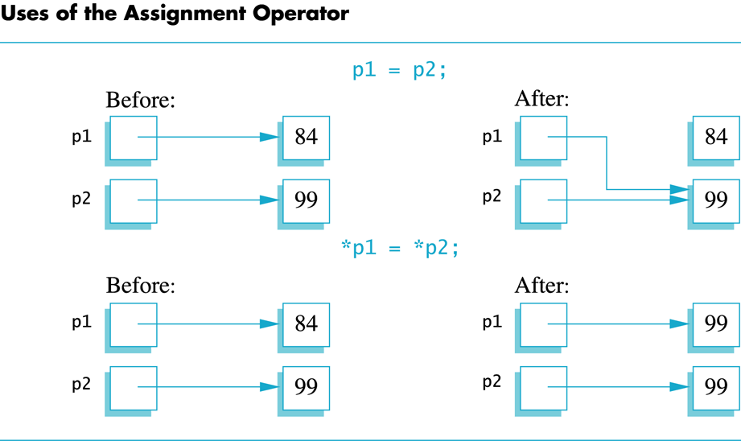
Display 12.1
Back
Next

Slide 70
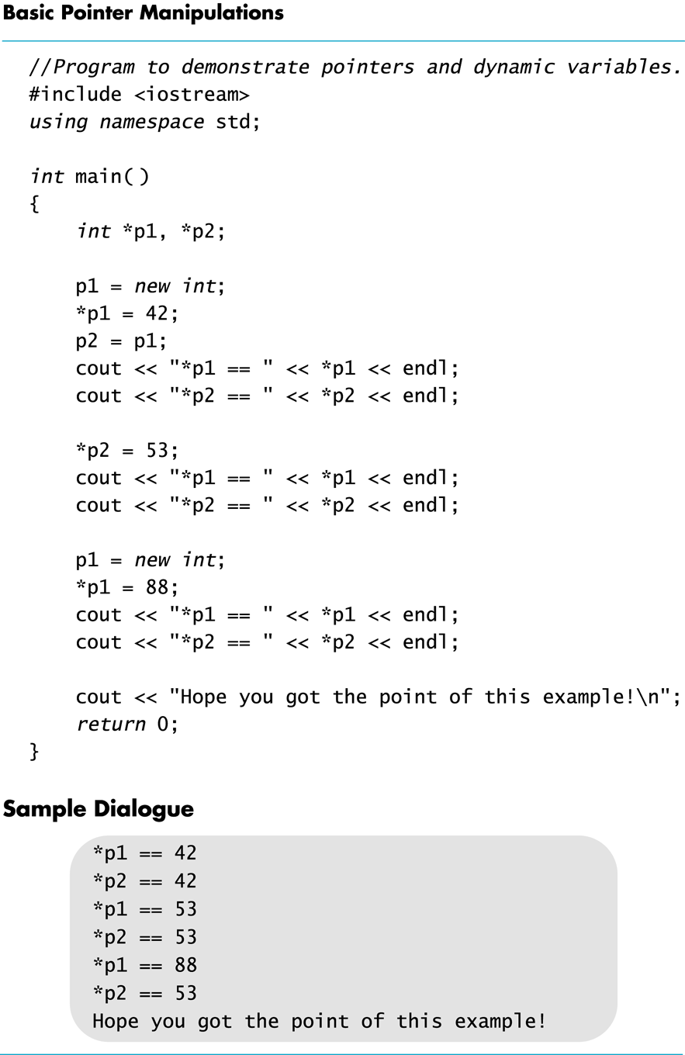
Display 12.2
Back
Next

Slide 71
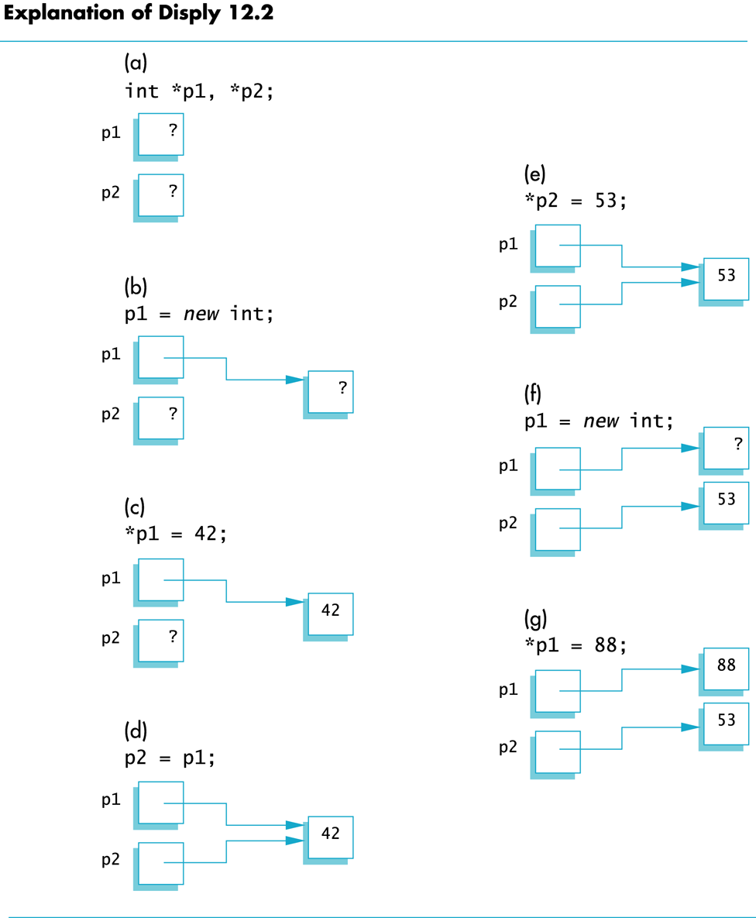
Display 12.3
Back
Next

Slide 72
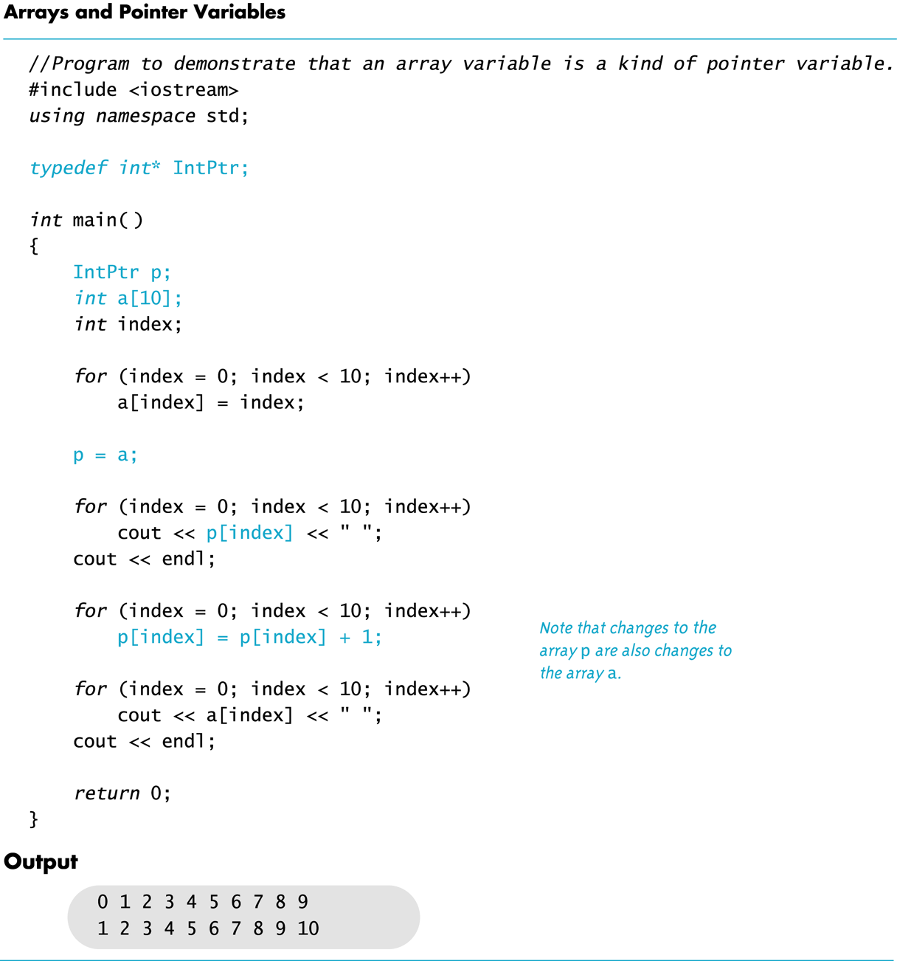
Display 12.4
Back
Next

Slide 73
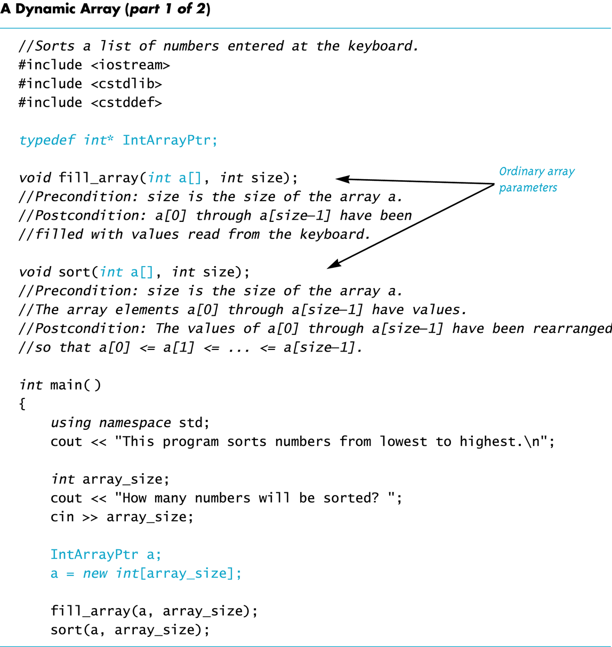
Display 12.5
(1/2)
Back
Next

Slide 74
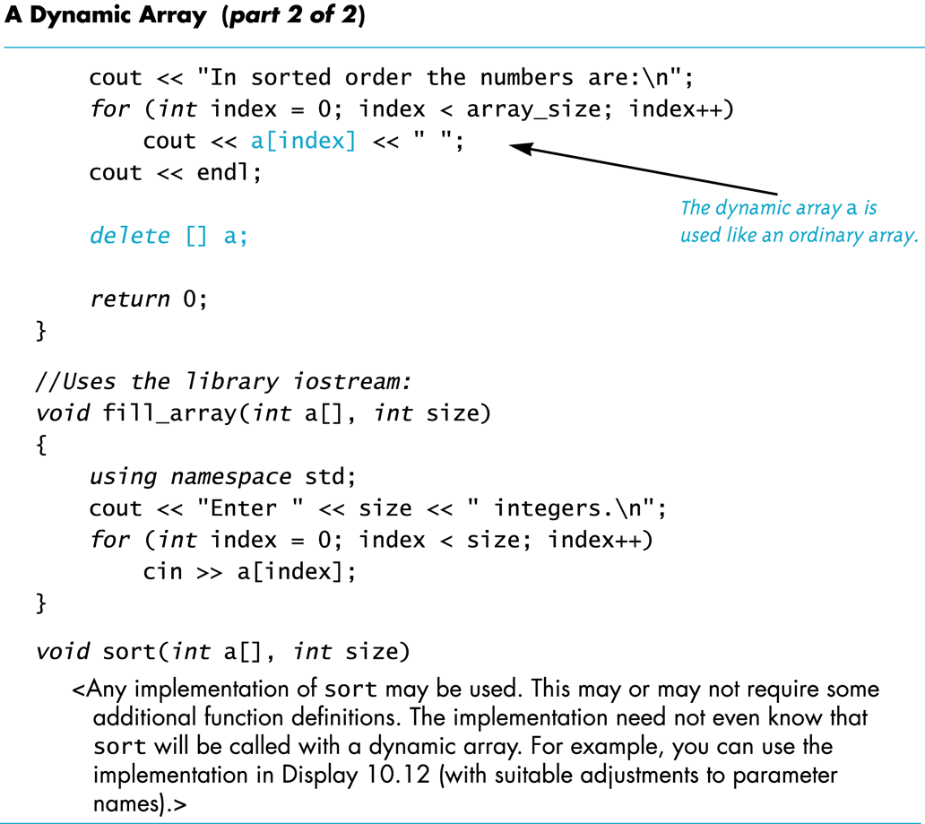
Display 12.5
(2/2)
Back
Next

Slide 75
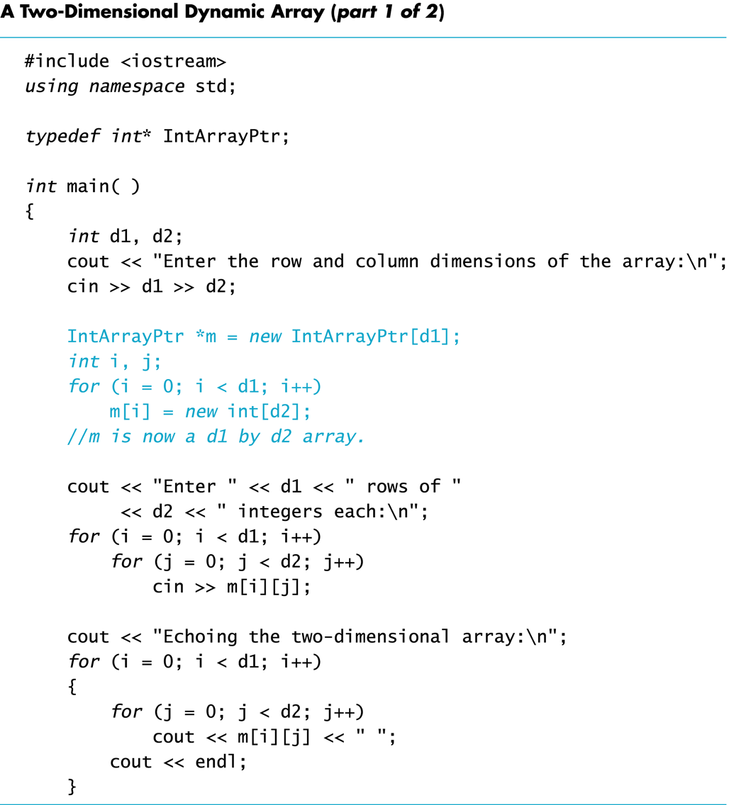
Display 12.6
(1/2)
Back
Next

Slide 76
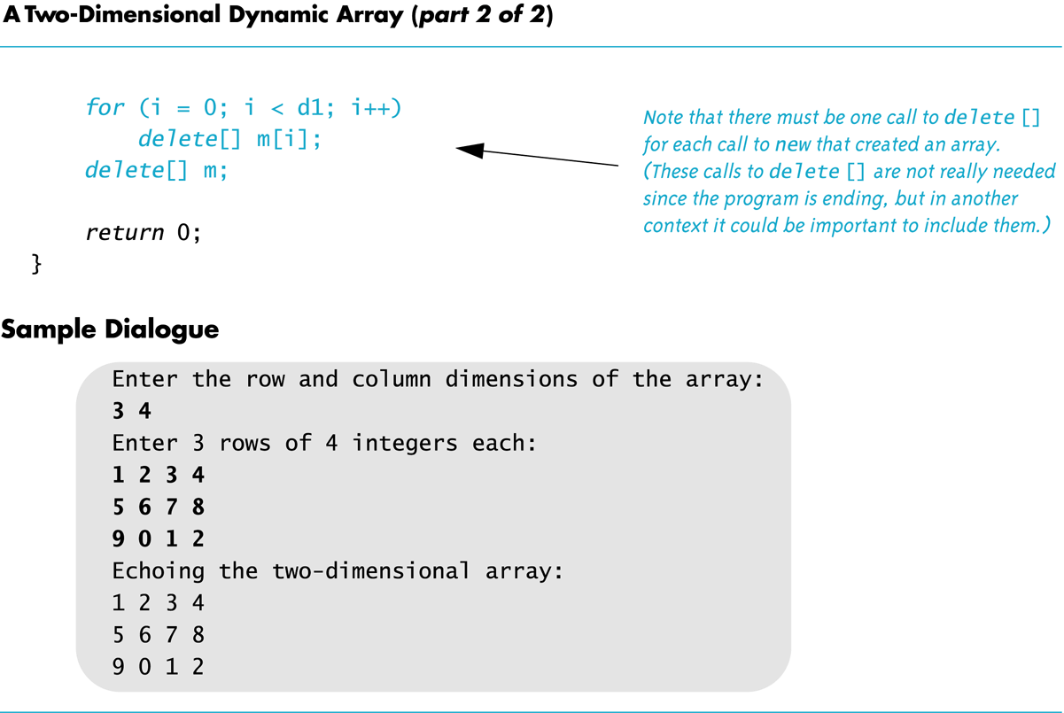
Display 12.6
(2/2)
Back
Next

Slide 77
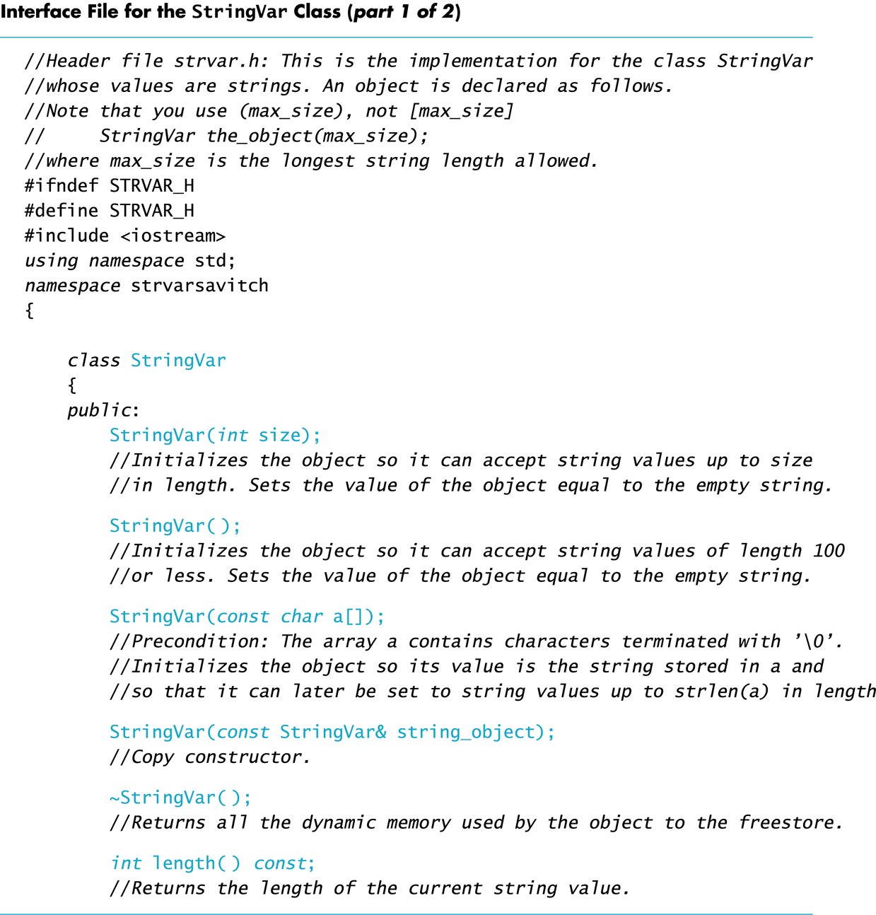
Display 12.7
(1/2)
Back
Next

Slide 78
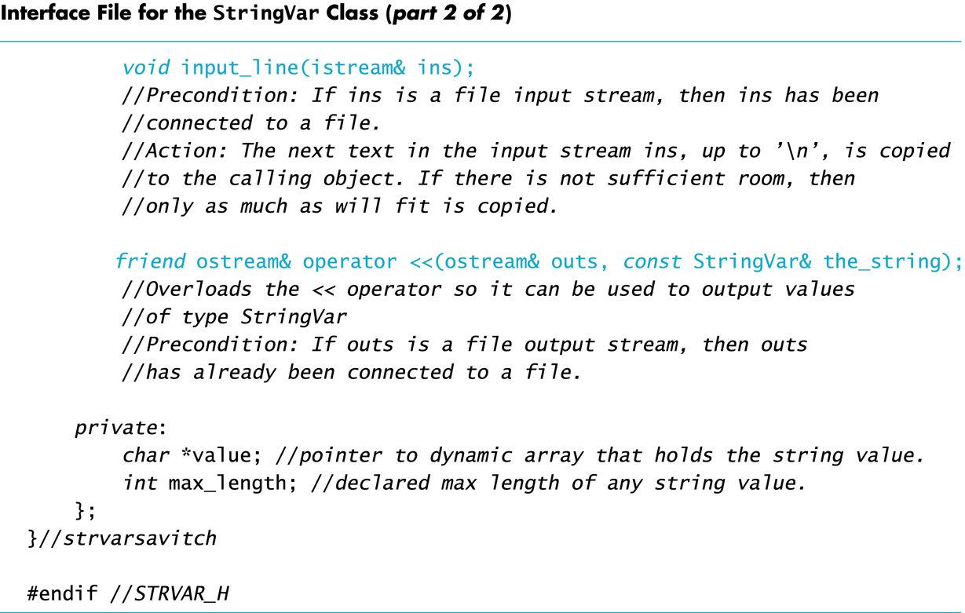
Display 12.7
(2/2)
Back
Next

Slide 79
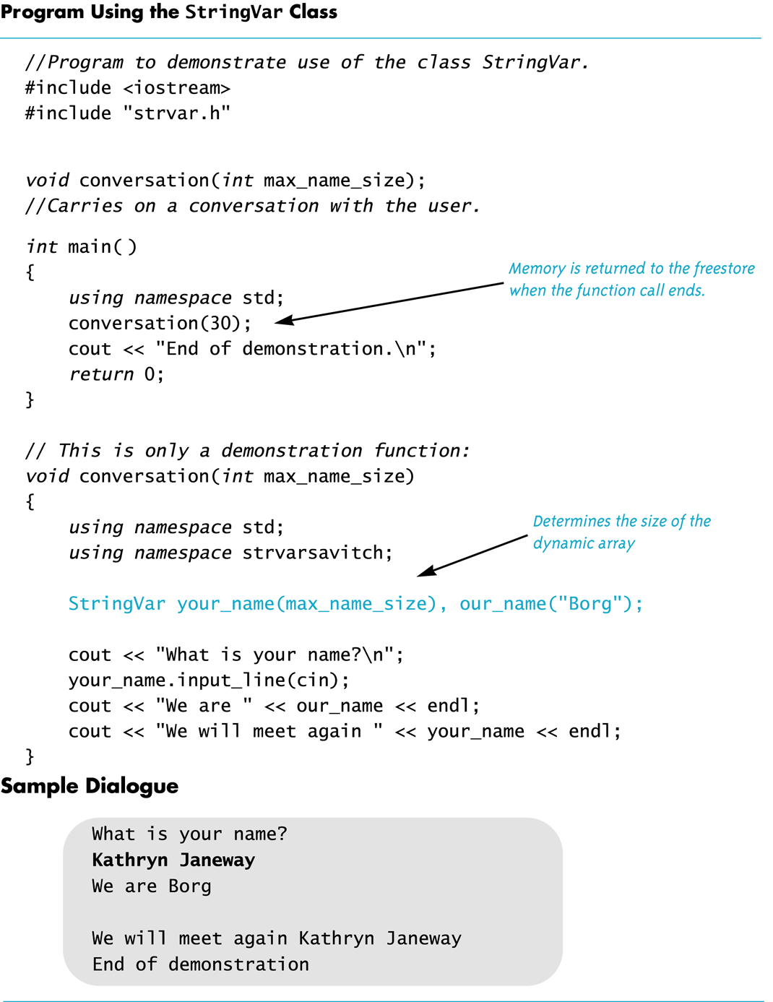
Display 12.8
Back
Next

Slide 80
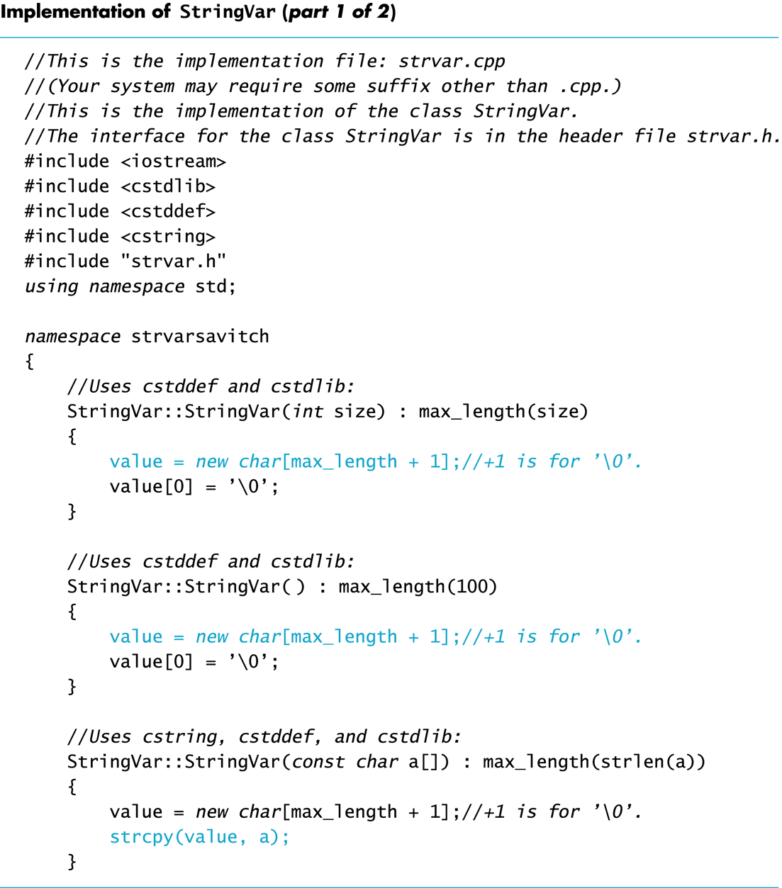
Display 12.9
(1/2)
Back
Next

Slide 81
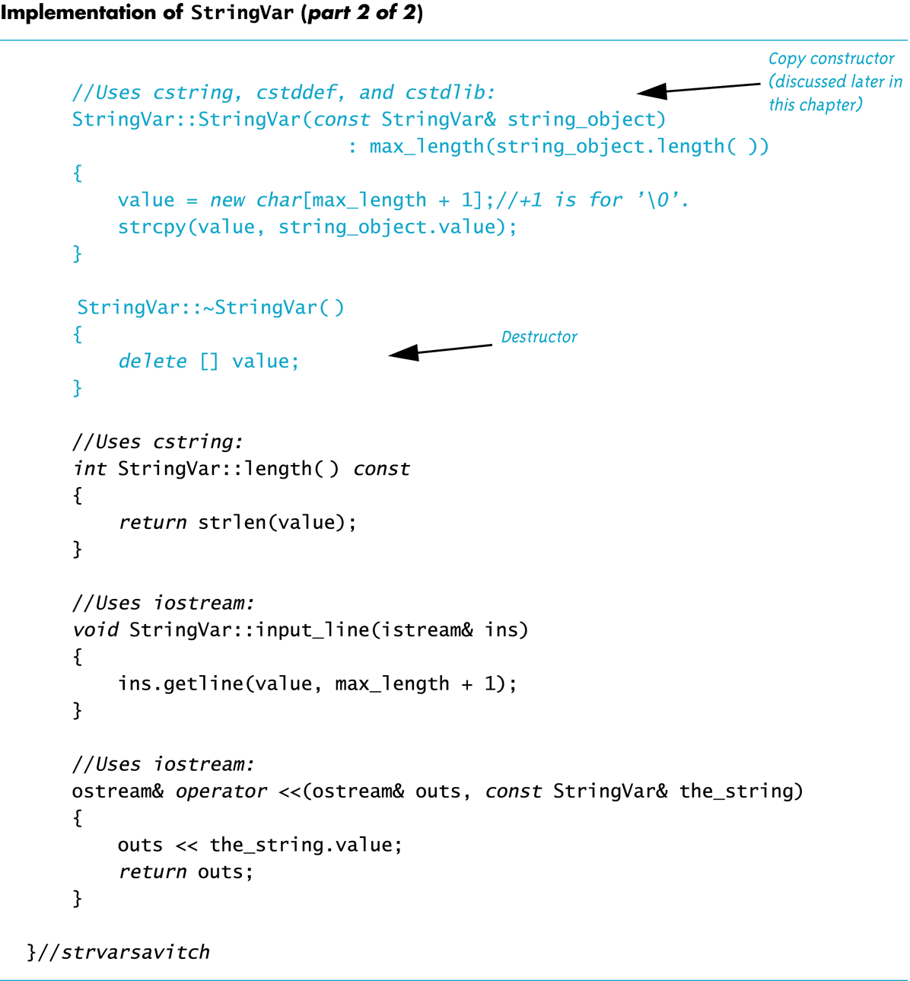
Display 12.9
(2/2)
Back
Next

Slide 82
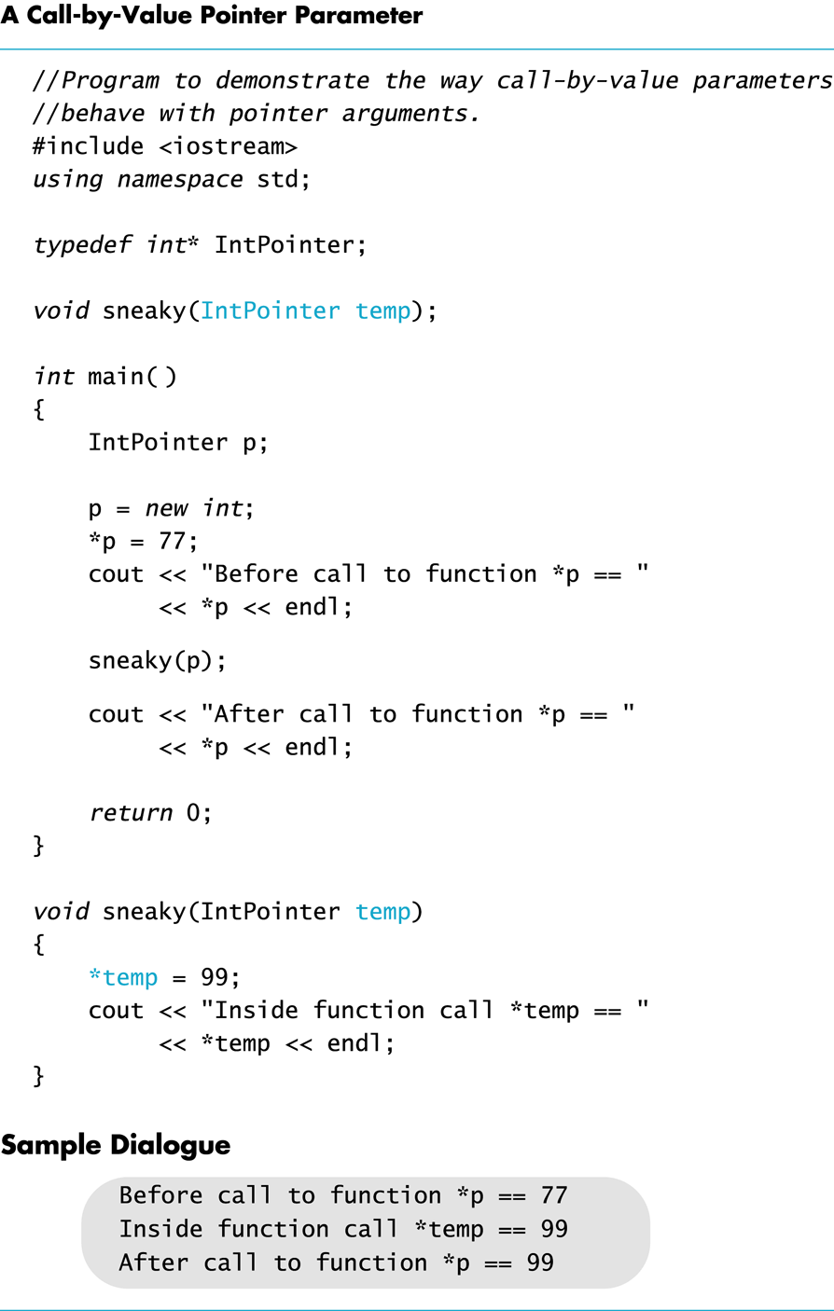
Display 12.10
Back
Next

Slide 83
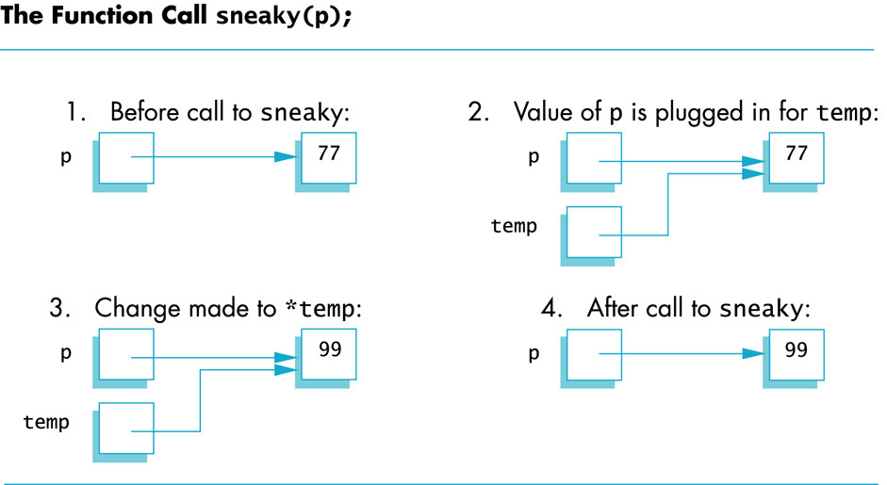
Display 12.11
Back
Next

